Slide 1
Analytics is Fun!
February 10, 2022

Slide 2

Question and Answer with Walt Type your questions in the chat section of this session.

Slide 3

Today’s Presenter
Walt DeGrange
Sports Analytics: Putting the Fun Back Into Analytics
Walt DeGrange is the Director for Analytics Capability for CANA Advisors where he helps organizations use analytics across federal and commercial domains. Prior to CANA Advisors, he had 21 years of Naval service as a Supply Corps Officer. The last 10 years in the Navy, his positions focused on supply chain analytics. He has taught courses in the MSOM program since 2014. Prior to that, he was an Assistant Military Professor at the Naval Postgraduate School in the Operations Research Department. Walt has also served on the Military Operations Research Society (MORS) Board of Directors and as the Chairperson for the INFORMS SpORts Section.

Slide 4
Charles Barkley (2015)
"Analytics don't work at all. It's just some crap that people who were really smart made up to try to get in the game because they had no talent. Because they had no talent to be able to play, so smart guys wanted to fit in, so they made up a term called analytics. Analytics don't work.”

Slide 5
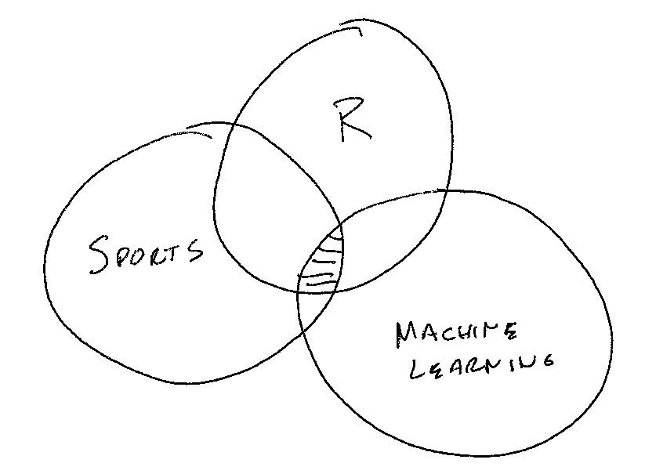
Why do this project?

Slide 6
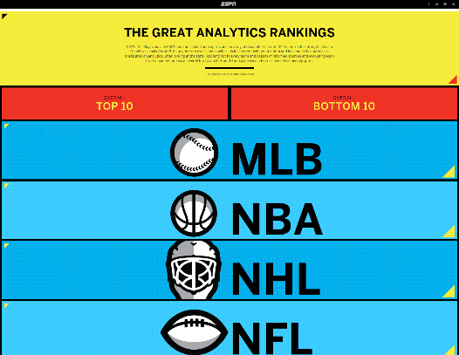
ESPN The Great Analytics Rankings (2015)
http://www.espn.com/espn/feature/story/_/id/12331388/the-great-analytics-rankings

Slide 7
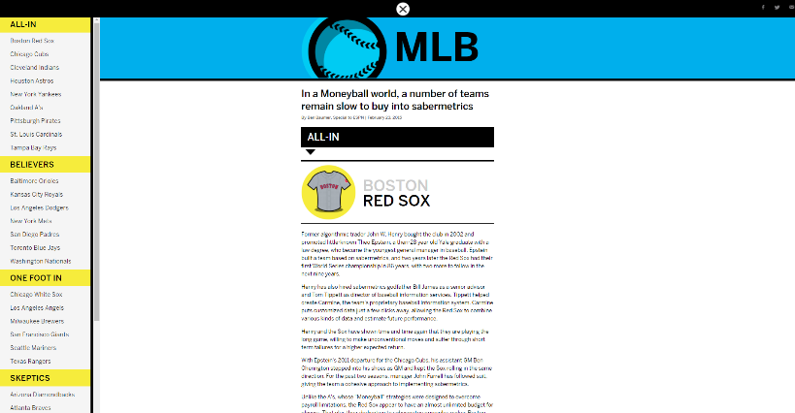
ESPN The Great Analytics Rankings (2015)
http://www.espn.com/espn/feature/story/_/id/12331388/the-great-analytics-rankings

Slide 8
Data
ESPN Analytics Ranking (1-5)
5 – All-in
4 – Believers
3 – One foot in
2 – Skeptics
1 - Nonbelievers
How far did the team go in the playoffs? (1-5)
5 – Champion
4 – Runner up
3 – Loss in third round
2 – Loss in second round
1 – Loss in first round
City size
2010 US Census
Canadian Cities Wikipedia
Salary – spotrac.com

Slide 9
Challenges
Team analytics have changed. 2015 ESPN ranking only performed once.
Salary data issues
Use available cap space for NHL, NFL, NBA
Use total team salary for MLB
Expansion
Las Vegas Golden Knights
Moving
2016 Rams - St. Louis to Los Angeles
2017 Chargers - San Diego to Los Angeles
2020 Raiders - Oakland to Las Vegas
Name Change
Washington Football Team
2020 US Census

Slide 10

https://github.com/ltwalt/espnsports

Slide 11
Overview By Sport
Sport | count | MeanESPN | StdESPN
MLB | 30 | 3.5 | 1.3
NBA | 30 | 3.1 | 1.2
NFL | 32 | 2.7 | 1.0
NHL | 31 | 3.4 | 0.9

Slide 12
Local Teams
Sport | City | Team | ESPN | HowFar
MLB | Dallas | Rangers | 3 | 1.43
NBA | Dallas | Mavericks | 5 | 0.57
NFL | Dallas | Cowboys | 4 | 0.86
NHL | Dallas | Stars | 3 | 1.14
MLB | Kansas City | Royals | 4 | 1.29
NFL | Kansas City | Chiefs | 4 | 2.43
NBA | Memphis | Grizzlies | 4 | 0.57

Slide 13
Champions 2014
Sport | Team | City | ESPNRating | PopulationMil
MLB | Giants | San Francisco | 3 | 0.9
NBA | GSWarriors | Oakland | 4 | 0.4
NFL | Patriots | Boston | 4 | 0.6
NHL | Blackhawks | Chicago | 5 | 2.7

Slide 14
Champions 2015
Sport | Team | City | ESPNRating | PopulationMil
MLB | Royals | Kansas City | 4 | 2.2
NBA | Cavaliers | Cleveland | 4 | 0.4
NFL | Broncos | Denver | 2 | 0.6
NHL | Penguins | Pittsburgh | 4 | 0.3

Slide 15
Champions 2016
Sport | Team | City | ESPNRating | PopulationMil
MLB | Cubs | Chicago | 5 | 2.7
NBA | GSWarriors | Oakland | 4 | 0.4
NFL | Patriots | Boston | 4 | 0.6
NHL | Penguins | Pittsburgh | 4 | 0.3

Slide 16
Champions 2017
Sport | Team | City | ESPNRating | PopulationMil
MLB | Astros | Houston | 5 | 2.1
NBA | GSWarriors | Oakland | 4 | 0.4
NFL | Eagles | Philadelphia | 4 | 1.6
NHL | Capitals | Washington | 4 | 6.1

Slide 17
Champions 2018
Sport | Team | City | ESPNRating | PopulationMil
MLB | RedSox | Boston | 5 | 0.6
NBA | Raptors | Toronto | 3 | 2.7
NFL | Patriots | Boston | 4 | 0.6
NHL | Blues | St Louis | 4 | 0.3

Slide 18
Champions 2019
Sport | Team | City | ESPNRating | PopulationMil
MLB | Nationals | Washington | 4 | 6.1
NBA | Lakers | Los Angeles | 1 | 3.8
NFL | Chiefs | Kansas City | 4 | 2.2
NHL | Lightning | Tampa Bay | 4 | 0.3

Slide 19
Champions 2020
Sport | Team | City | ESPNRating | PopulationMil
MLB | Dodgers | Los Angeles | 4 | 3.8
NBA | Bucks | Milwaukee | 3 | 0.6
NFL | Buccaneers | Tampa Bay | 3 | 0.3
NHL | Lightning | Tampa Bay | 4 | 0.3

Slide 20
ESPN Rating
ESPNRating | Count | HowFar | MeanPop | MeanSalary
1 | 10 | 0.4 | 4.3 | 17.6
2 | 27 | 0.7 | 1.8 | 17.3
3 | 34 | 0.7 | 0.9 | 16.5
4 | 37 | 1.3 | 1.7 | 13.9
5 | 15 | 1.3 | 1.7 | 14.7

Slide 21
ESPN Ranking Best Performance
Sport | Team | City | ESPNRating | PopulationMil | HowFar
NBA | GSWarriors | Oakland | 4 | 0.4 | 3.29
NFL | Patriots | Boston | 4 | 0.6 | 3.29
MLB | Dodgers | Los Angeles | 4 | 3.8 | 3.14
NHL | Lightning | Tampa Bay | 4 | 0.3 | 3.00
NHL | Golden Knights | Las Vegas | 5 | 0.6 | 2.67
NBA | Cavaliers | Cleveland | 4 | 0.4 | 2.43
NFL | Chiefs | Kansas City | 4 | 2.2 | 2.43
MLB | Astros | Houston | 5 | 2.1 | 2.43
NHL | Penguins | Pittsburgh | 4 | 0.3 | 2.14
NBA | Raptors | Toronto | 3 | 2.7 | 2.14

Slide 22
ESPN Ranking Worst Performance
Sport | Team | City | ESPNRating | PopulationMil | HowFar
MLB | Pirates | Pittsburgh | 5 | 0.3 | 0.29
NBA | Mavericks | Dallas | 5 | 1.2 | 0.57
MLB | As | Oakland | 5 | 0.4 | 0.71
MLB | Rays | Tampa Bay | 5 | 0.3 | 0.86
NBA | 76ers | Philadelphia | 5 | 1.6 | 1.00
NBA | Spurs | San Antonio | 5 | 1.5 | 1.14
NHL | Blackhawks | Chicago | 5 | 2.7 | 1.14
MLB | RedSox | Boston | 5 | 0.6 | 1.29
MLB | Gardians | Cleveland | 5 | 0.4 | 1.29
MLB | Yankees | New York | 5 | 8.6 | 1.57

Slide 23
Los Angeles Team Performance
Sport | Team | ESPN | HowFar
MLB | Angels | 3 | 0.29
MLB | Dodgers | 4 | 3.14
NBA | Clippers | 2 | 1.43
NBA | Lakers | 1 | 0.86
NFL | Chargers | 1 | 0.29
NFL | Rams | 2 | 1.00
NHL | Ducks | 2 | 1.14
NHL | Kings | 4 | 0.29

Slide 24
New York Team Performance
Sport | Team | ESPN | HowFar
MLB | Mets | 4 | 0.71
MLB | Yankees | 5 | 1.57
NBA | Knicks | 1 | 0.29
NBA | Nets | 1 | 0.57
NFL | Giants | 2 | 1.14
NFL | Jets | 1 | 1.00
NHL | Islanders | 4 | 1.57
NHL | Rangers | 2 | 1.43

Slide 25
Small City's Team Performance
Sport | Team | ESPN | HowFar | PopulationMil
NFL | Packers | 3 | 2.00 | 0.1
NHL | Panthers | 3 | 1.29 | 0.1

Slide 26
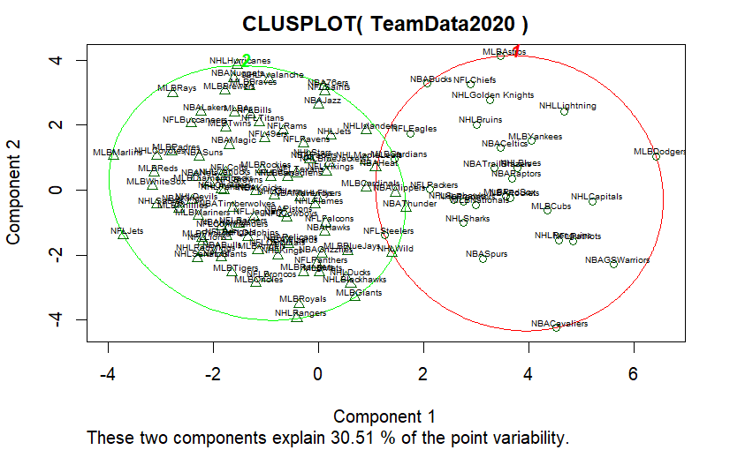
2020 K-Means Clustering Plot

Slide 27
2020 K-Means Clustering Data
Cluster | Teams | MeanX2014HF | MeanX2015HF | MeanX2016HF | MeanX2017HF | MeanX2018HF | MeanX2019HF | MeanX2020HF | MeanPopulation | MeanSalary | MeanESPNRating
1 | 29 | 1.5 | 1.9 | 2.3 | 2.5 | 2.2 | 1.7 | 1.4 | 1.7 | 11.2 | 4.0
2 | 94 | 0.8 | 0.6 | 0.5 | 0.4 | 0.5 | 0.7 | 0.9 | 1.7 | 17.3 | 2.9

Slide 28
